Slide 1

<Prospect Name>
Electronic Contracts
increasing the return on your contract base

Slide 2

Introducing Senority
Founded by a group of people with deep experience in the services industry who collectively have been challenged over the years because there is no simple "solution" that can help complex client supplier relationships
We have identified the gap, validated the demand, determined the scope and mobilised industry experts and developed Evaluetor©
We have created a solution that consists of 3 pillars
Evaluetor©
Cloud based Software solution;
Secure processes in a workbench enabling integrated management
Process templates
We can lead or facilitate, your choice
Using experience driven proven processes
Advisory group
Strength in Knowledge
Experienced advisors that help your organisation with the process framework

Slide 3
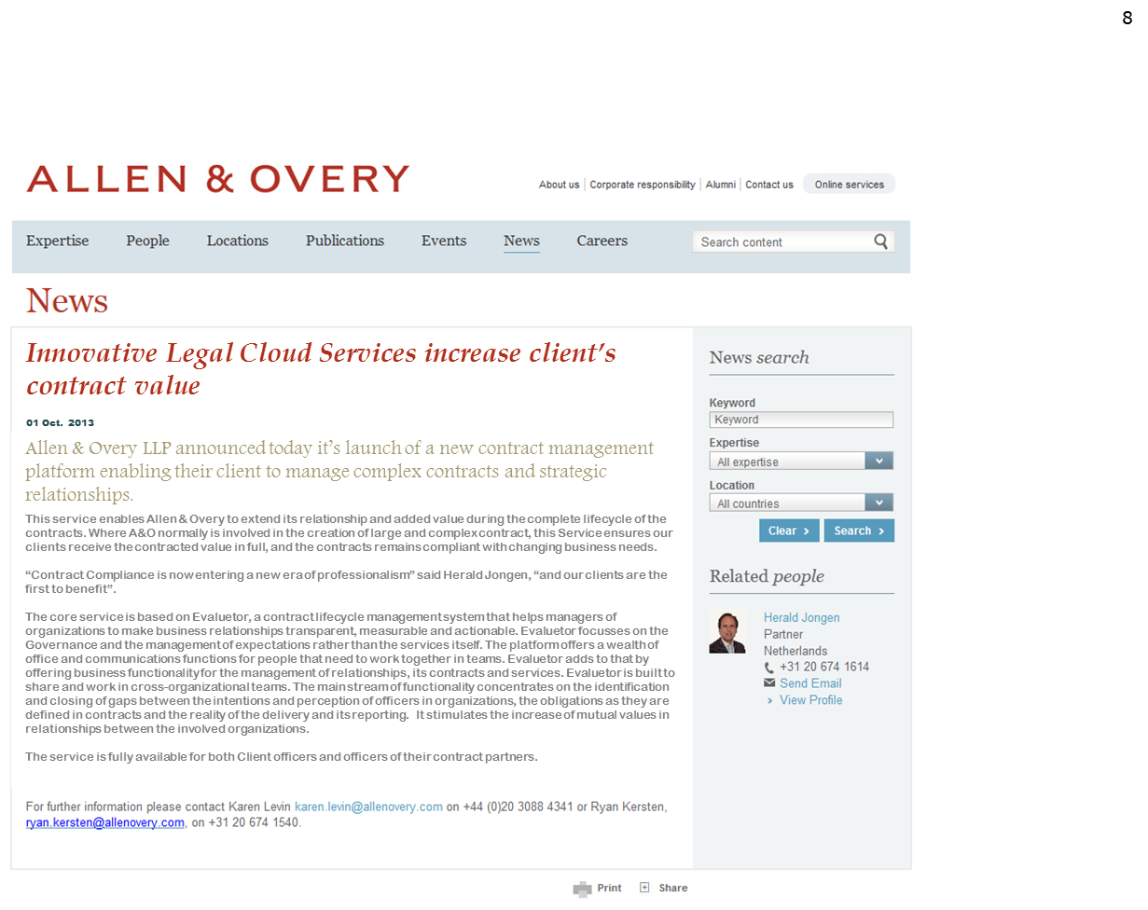

Slide 4


Supporting the lifecycle
CLIENT
Scope change
Scope change
dissatisfaction
complaint
contract
contract
Add-on
dispute
Legislation change
New requirement
Contracting
execution
Close/renewal
SUPPLIER

Slide 5
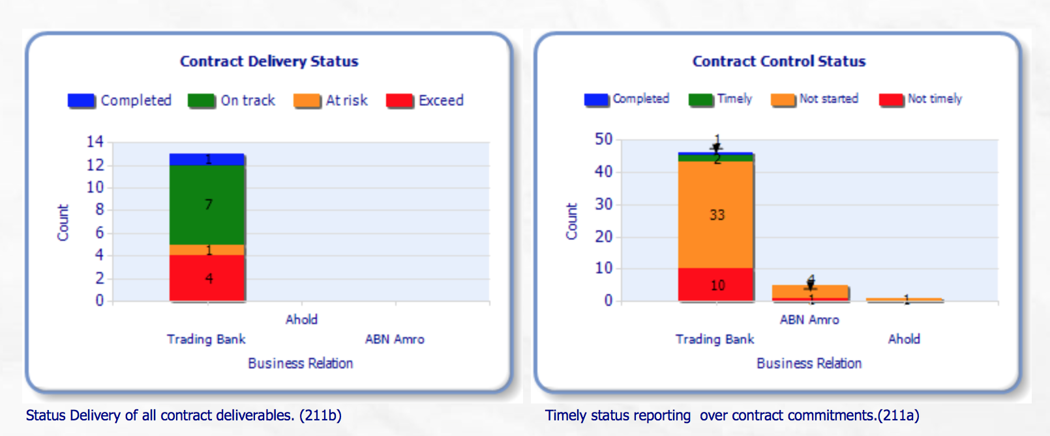
Contract Execution & Governance
Increased Value from your contracts
Online access and control of all your Contract Documents
Proactive alerts of Risks to those responsible in your business
Proactive management of commitments realising the full potential Value
Contract content selectively pushed out to your business management
Avoid problem resolution cost

Slide 6

Allen & Overy E*Contract Services
Option to deliver Electronic contracts, using Evaluetor
Contract clauses translated in commitments in business terms
Commitment follow up assigned to governance teams
Control cycles defined on commitments to assure frequent monitoring and compliance
Contract Monitoring Services
Advising on the Contract Management process, using the control information in Evaluetor
Real-time Legal analytics
Contract Risk Management Services
Using the risk management information in Evaluetor to create risk assessments
Draft

Slide 7
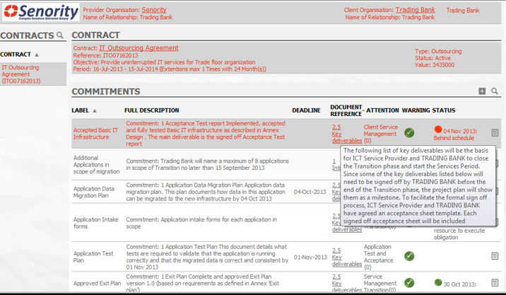

Translate your Contract Documents into
manageable Commitments, Actions and Alerts

Slide 8
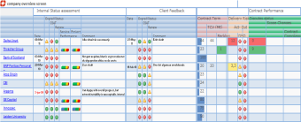



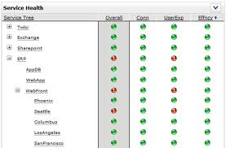
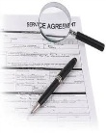


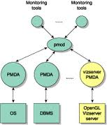
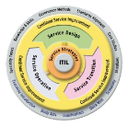


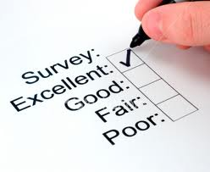
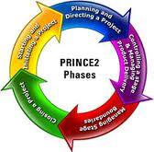

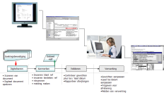
How the information comes together
Evaluetor Dashboard
Perception based
Fact based
Account Team Score
Client Score
Improvement
Plan Status
Delivery Performance
Contract performance
Account Staff
Client Interview
Go to Green status collection
Services Metric collection (SLA)
Alerts
Delivery Staff
Web based Survey
Project
Metric
Collection
Contracting (client & supplier)
Contracts
Upload

Slide 9
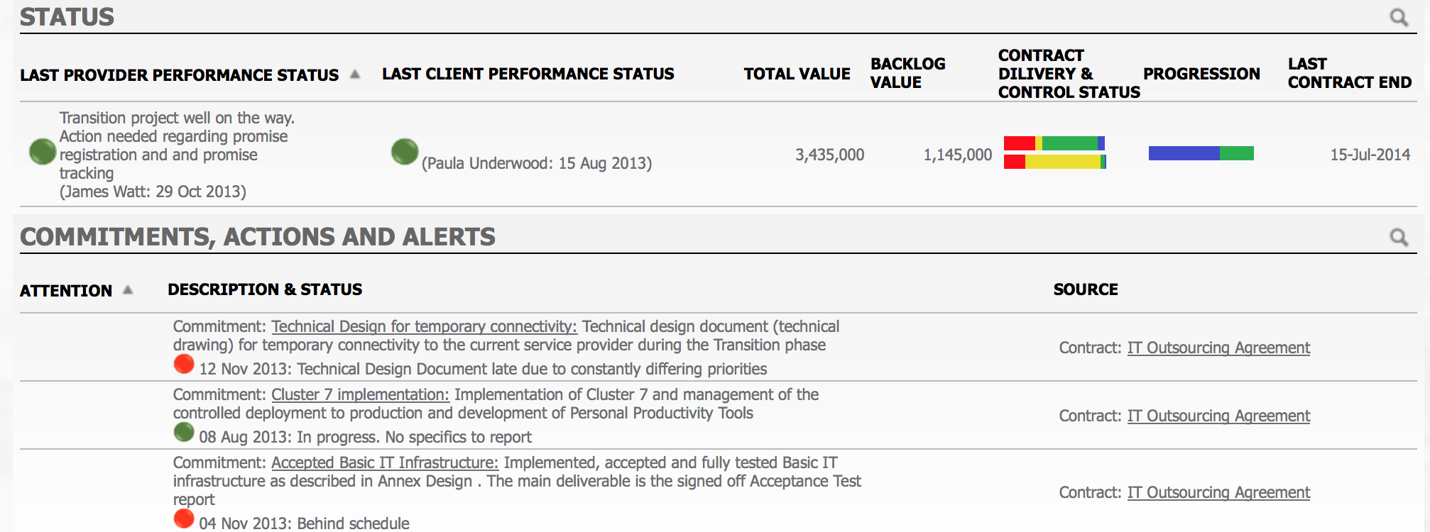
Manage Commitments, Actions and Alerts from your Contracts

Slide 10
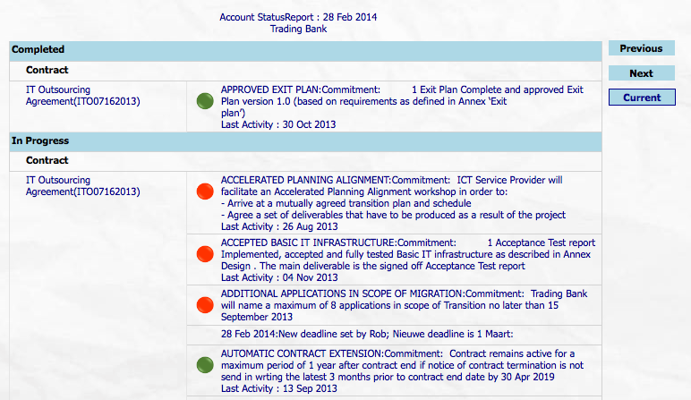
Zoom in to details

Slide 11
Evaluetor© Value delivered
Increase return on contract base
by 3-5%
Jointly developed with Allen & Overy
Increase renewal rate
and
Contract extensions
Trusted Transparent relationship
Avoid transition costs
Improve margins (decrease costs)
Pro-actively action commitments and avoid omissions
Increase revenue
Growth of add-on business within the existing customer portfolio

Slide 12
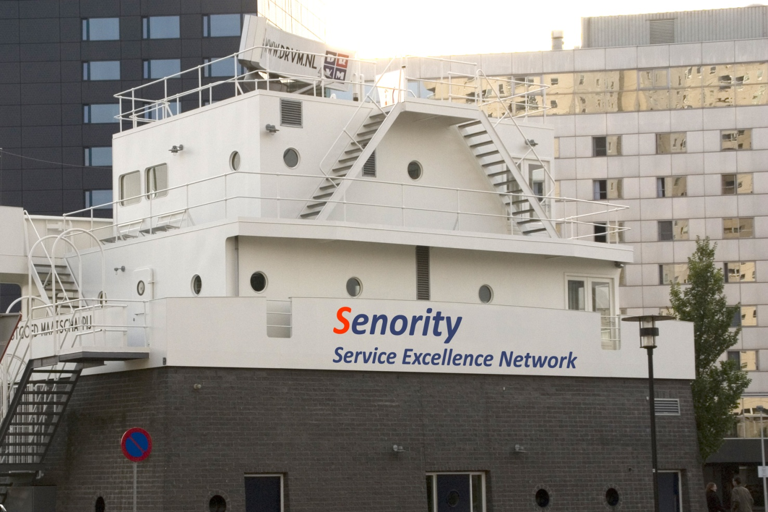
Contact
Steven E. Visser
Managing Partner - Senority Boompjes 680 3011 XZ Rotterdam
The Netherlands Tel: +31 (0) 10 217 0118 Fax: +31 (0) 10 213 0133 Mobile: +31 (0) 631003495 Steven.Visser@senority.nl www.Senority.nl

Slide 13
appendices

Slide 14
Evaluetor Concept
Expectations
Commercial gap
Contract
Delivery gap
Performance
Information gap
Reporting

Slide 15
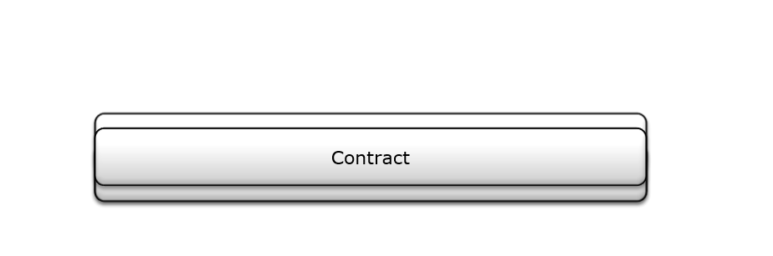
Evaluetor.. Closing the Gap

Slide 16
Evaluetor
Contract
Management
Relationship
Management
Improvement
Management
Service
Management

Slide 17
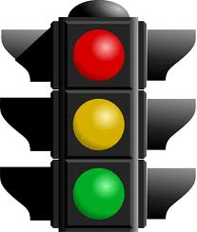
Contract Management
Contracts
Status
Updates
Control
Cycle
Active
Improvement
Management
Commitments
Operations
Frequency:
Daily
Weekly
Monthly
Once
Alert based

Slide 18





Relationship Management
KPI Scoring
Delivery team
Account Manager
Summary
Control
Cycle
Improvement
Management
KPI Scoring
Client team
Contract
Manager
Summary

Slide 19

Improvement Management
Commitment
Governance
Team A
Governance
Team B
Relationship
KPI’s
Governance
Team C
New
Updated
Improvement
Actions
Service
KPI’s
Governance
Team D
Governance
Team E
Improvement
Actions

